Slide 1
Sequential Circuits

Slide 2
Sequential Circuits
In the previous session, we said that the output of a combinational circuit depends solely upon the input.
The implication is that combinational circuits have no memory. In order to build sophisticated digital logic circuits, including computers, we need more a powerful model.
We need circuits whose output depends upon both the input of the circuit and its previous state. In other words, we need circuits that have memory.

Slide 3
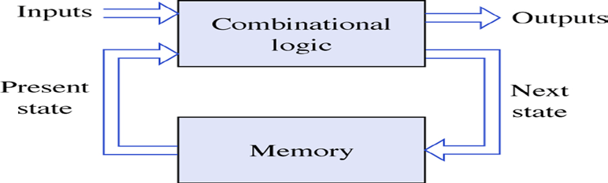
Sequential Circuits
For a device to serve as a memory, it must have three characteristics:
  the device must have two stable states
  there must be a way to read the state of the device
  there must be a way to set the state at least once.

Slide 4
Latches and Flip Flop
In the same way that gates are the building blocks of combinatorial circuits, latches and flip-flops are the building blocks of sequential circuits.
While gates had to be built directly from transistors, latches can be built from gates, and flip-flops can be built from latches. This fact will make it somewhat easier to understand latches and flip-flops.

Slide 5
Latches and Flip Flop
Both latches and flip-flops are circuit elements whose output depends not only on the current inputs, but also on previous inputs and outputs. The difference between a latch and a flip-flop is that a latch does not have a clock signal, whereas a flip-flop always does.
Common examples of latches:
  S-R latch, S-R latch, D latch (= gated D latch)
Common examples of flip-flops (FF):
  D-FF, D-FF with enable, Scan-FF, JK-FF, T-FF

Slide 6
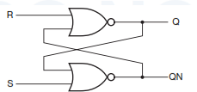
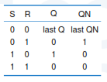
S-R Latch
Circuit Design Using NOR gates
Function Table:
hold, no change
Reset
Set
not allowed, unstable (Q=QN)

Slide 7
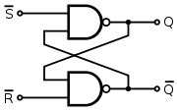
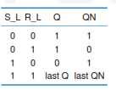
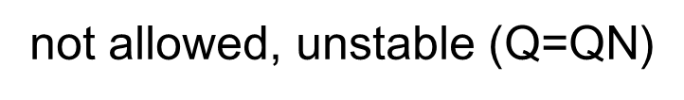
S-R latch
Function table:

Slide 8
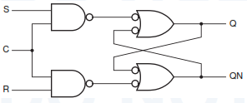
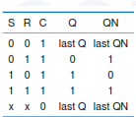
Clocked (NOR) S-R Latch
Clk=0: input has no effect: latch is always in “hold” mode (retain its previous state)
Clk=1: latch is a regular S-R latch
Notes:
Considered as Flip Flop

Slide 9
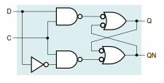
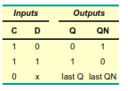
D latch
Function table:

Slide 10
Flip-Flop
Latches a re a synchronous, which means that the output changes very soon after the input changes. Most computers today, on the other hand, are synchronous, which means that the outputs of all the sequential circuits change simultaneously to the rhythm of a global clock signal.
A flip-flop is a synchronous version of the latch.

Slide 11
Flip-Flop
A flip-flop circuit can be constructed from two NAND gates or two NOR gates. Each flip-flop has two outputs, Q and Q′, and two inputs, set and reset. This type of flip-flop is referred to as an SR flip-flop or SR latch. The flip-flop in has two useful states. When Q=1 and Q′=0, it is in the set state (or 1 -state). When Q =0 an d Q′=1, it is in the clear state (or 0 -state).

Slide 12
Flip-Flop
The outputs Q and Q′ are complements of each other and are referred to as the normal and complement outputs, respectively. The binary state of the flip-flop is taken to be the value of the normal output.

Slide 13
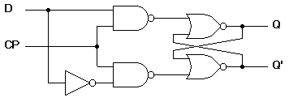

D Flip-Flop
If D input is 1, the flip-flop is switched to the set state (unless it was already set). If it is 0, the flip-flop switches to the clear state.

Slide 14
J-K Flip-flop
Behavior of JK flip-flop:
  Same as S-R flip-flop with J analogous to S and K analogous to R
  Except that J = K = 1 is allowed, and
  For J = K = 1, the flip-flop changes to the opposite state (toggle)
Behavior described by the characteristic table (function table):
J
Q
C
K
J K Q(t+1)
0 0 Q(t) no change
0 1 0 reset
0 1 set
1 1 Q(t) toggle

Slide 15
T Flip-flop
Behavior described by its characteristic table:
  Has a single input T
    For T = 0, no change to state
    For T = 1, changes to opposite state
T Q(t+1)
0 Q(t) no change
1 Q(t) complement
Characteristic equation:
Q(t+1)=T’Q(t) + TQ’(t)
= T⊕Q(t)
T
C

Slide 16
Flip-Flop Characteristic Tables
D | Q(t+1)
0 | 0
1 | 1
D
Q
Reset
Set
Q
J | K | Q(t+1)
0 | 0 | Q(t)
0 | 1 | 0
1 | 0 | 1
1 | 1 | Q’(t)
J
Q
No change
Reset
Set
Toggle
K
Q
T
Q
T | Q(t+1)
0 | Q(t)
1 | Q’(t)
No change
Toggle
Q

Slide 17
Flip-Flop Characteristic Equations
D | Q(t+1)
0 | 0
1 | 1
D
Q
Q(t+1) = D
Q
J | K | Q(t+1)
0 | 0 | Q(t)
0 | 1 | 0
1 | 0 | 1
1 | 1 | Q’(t)
J
Q
Q(t+1) = JQ’ + K’Q
K
Q
T
Q
T | Q(t+1)
0 | Q(t)
1 | Q’(t)
Q(t+1) = T ⊕ Q
Q

Slide 18
Characteristics Equation
Specify next state as a function of its current state and inputs
Q(t) →current state
Q(t+1) →next state
For example:
SR latch: Q(t+1) = S + R’Q(t)
D flip-flop: Q(t+1) = D
JK flip-flop: Q(t+1) = JQ’(t)+K’Q(t)
T flip-flop: Q(t+1) = T⊕Q(t)= TQ’(t)+T’Q(t)

